Slide 1
Smart Customer Purchase Analytics and Recommendation System
TEAM NO- 12
MENTOR: Dr N. Shirisha, Assoc.Prof.
TEAM MEMBERS:
2320030284 – N.V Sumanth Reddy 2320030020 – Manikanta
2320030002 – s.Rahul

Slide 2
TABLE OF CONTENTS
Review2 comments
module-wise implementation
Comparison and discussion(Graphical representation)
Results
conclusion
Future Direction
References

Slide 3
REVIEW – 2 COMMENTS ADDRESSED
Modules of the project need to analyse
Tools /Requirements gather

Slide 4
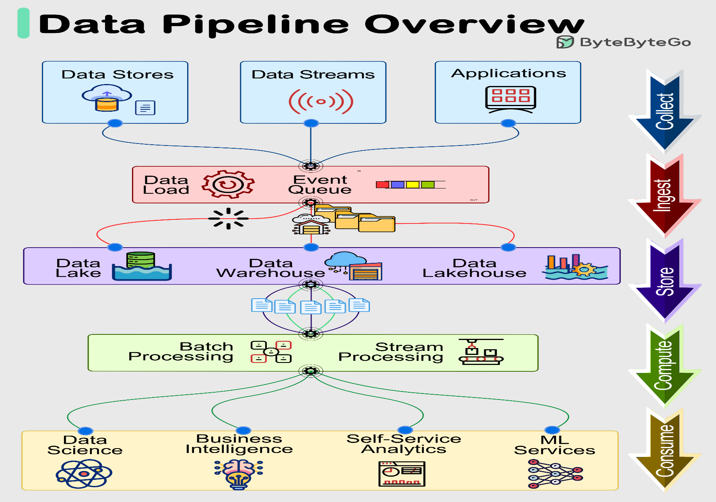
MODULE WISE IMPLEMNENTATION
1. Data Ingestion Module (Apache Kafka)

Slide 5
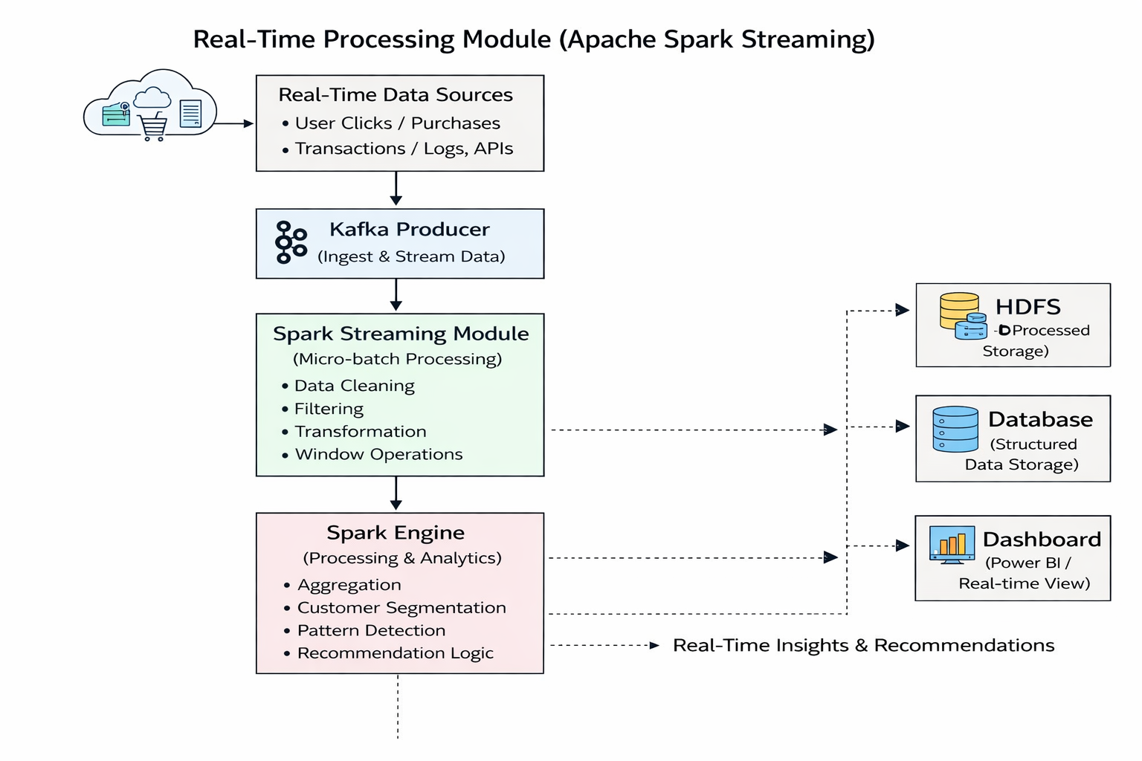

2. Real-Time Processing Module (Apache Spark Streaming)

Slide 6
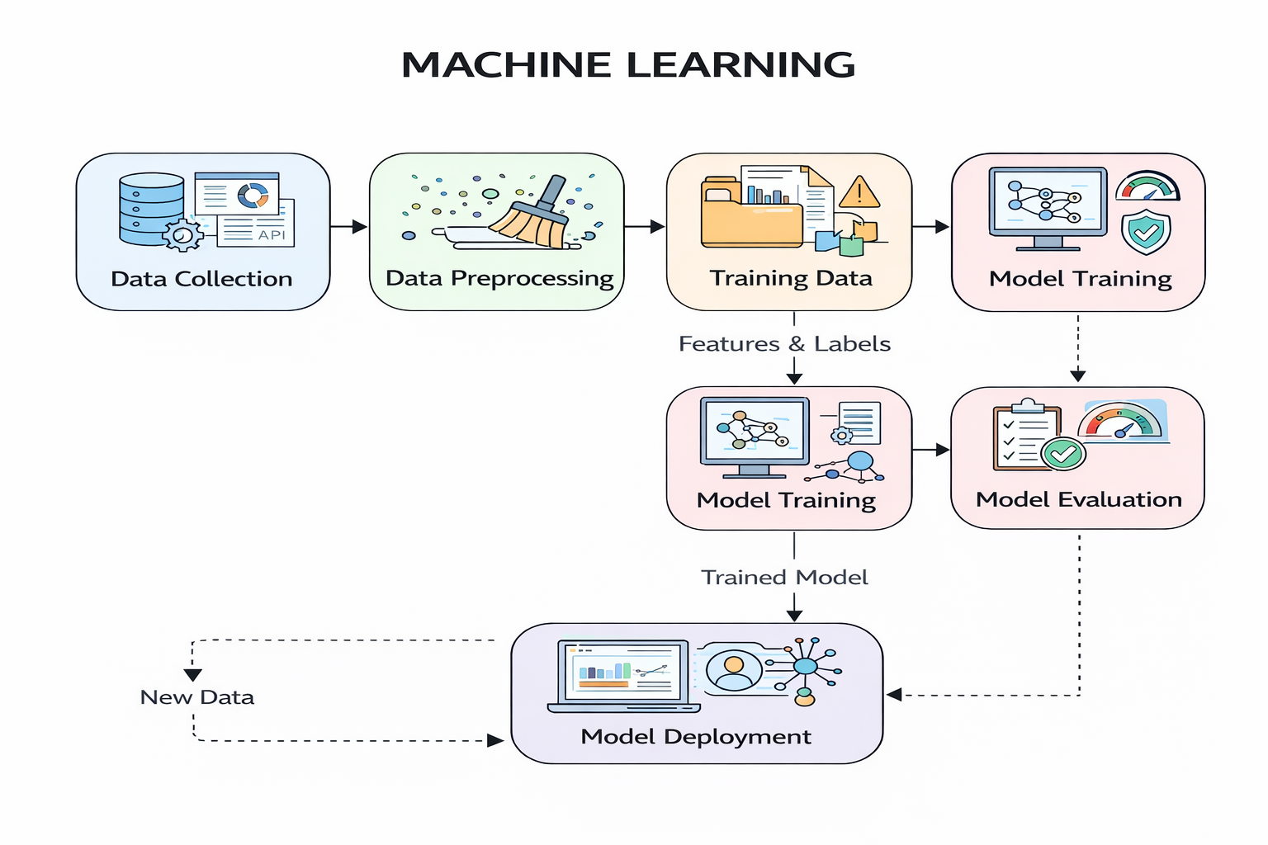
3. MACHINE LEARNING

Slide 7
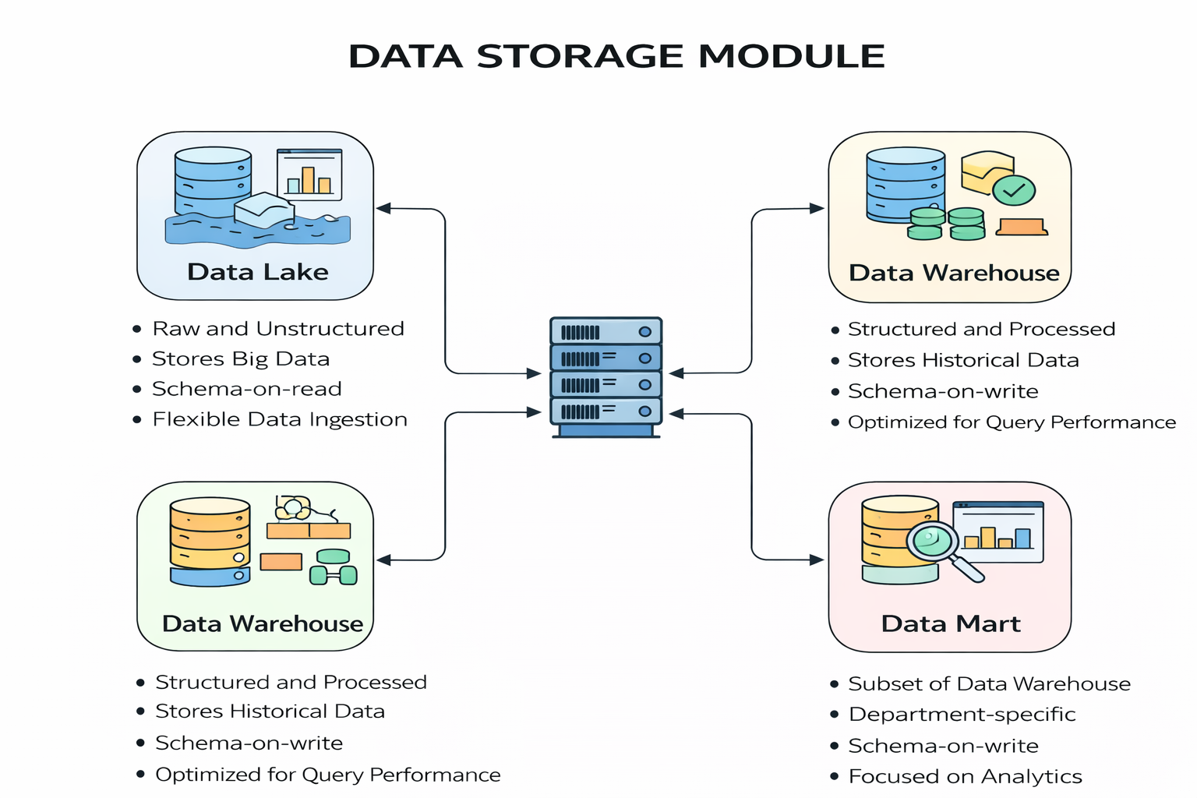
4. DATA STORAGE MODULE

Slide 8
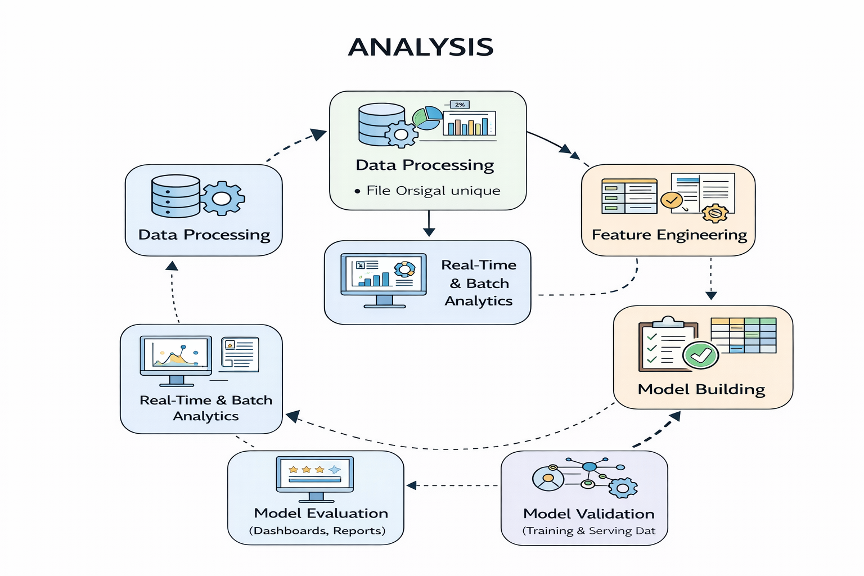
5.ANALYSIS

Slide 9
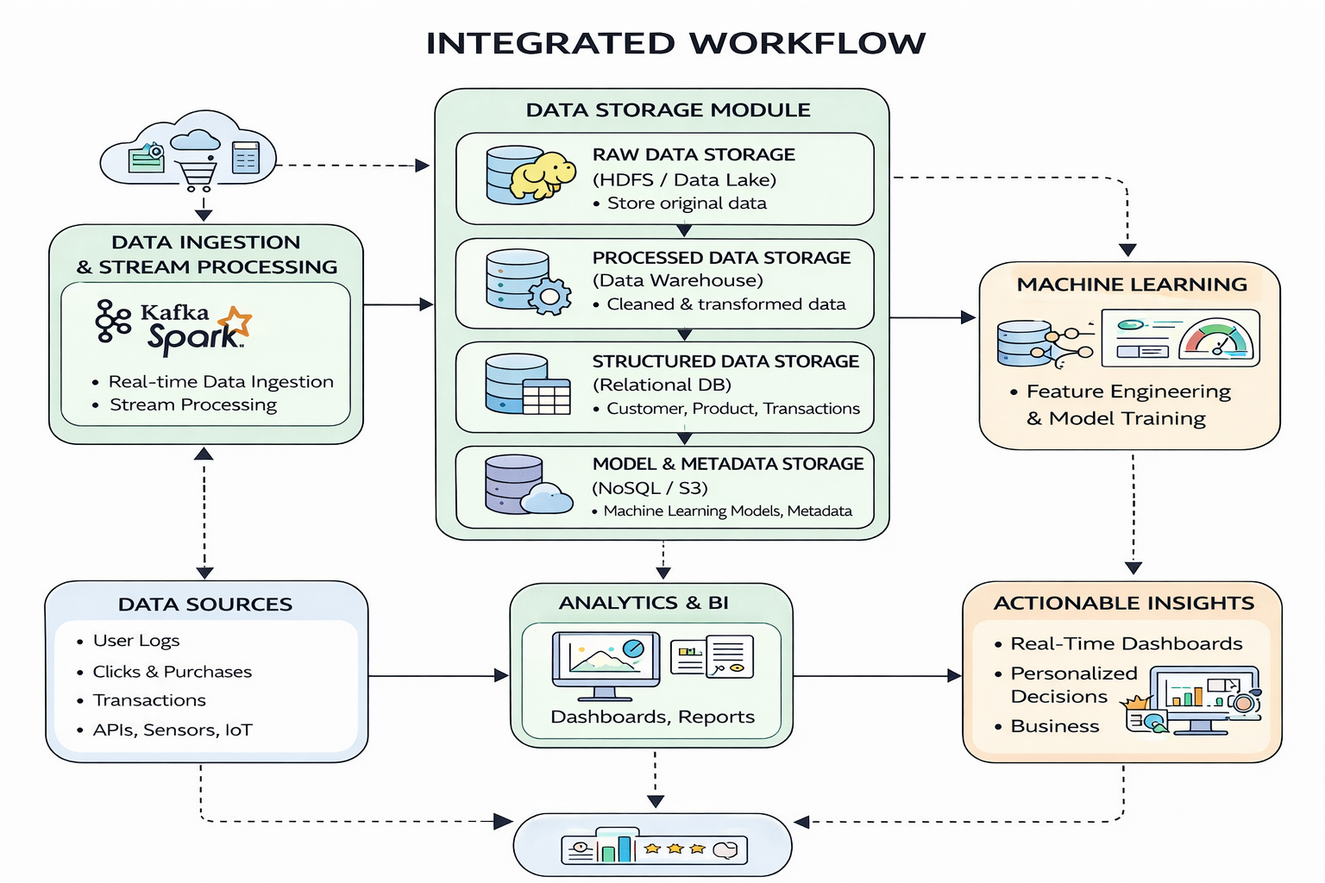
6.INTEGRATED WORKFLOW

Slide 10
COMPARISON
Feature | Traditional System (Batch) | Proposed System (Real-Time) | ML-Based Intelligent System
Data Processing | Batch (periodic) | Continuous streaming (Kafka + Spark) | Real-time + predictive processing
Latency | High (minutes to hours) | Low (seconds) | Very low + predictive (near real-time decisions)
Scalability | Limited (Hadoop batch jobs) | Highly scalable (distributed streaming) | Highly scalable with model optimization
Recommendation | Delayed / static | Instant (rule-based / streaming) | Personalized & predictive recommendations
Technology | Hadoop, MapReduce | Kafka, Spark Streaming | ML Algorithms (Apriori, K-Means) + Spark

Slide 11
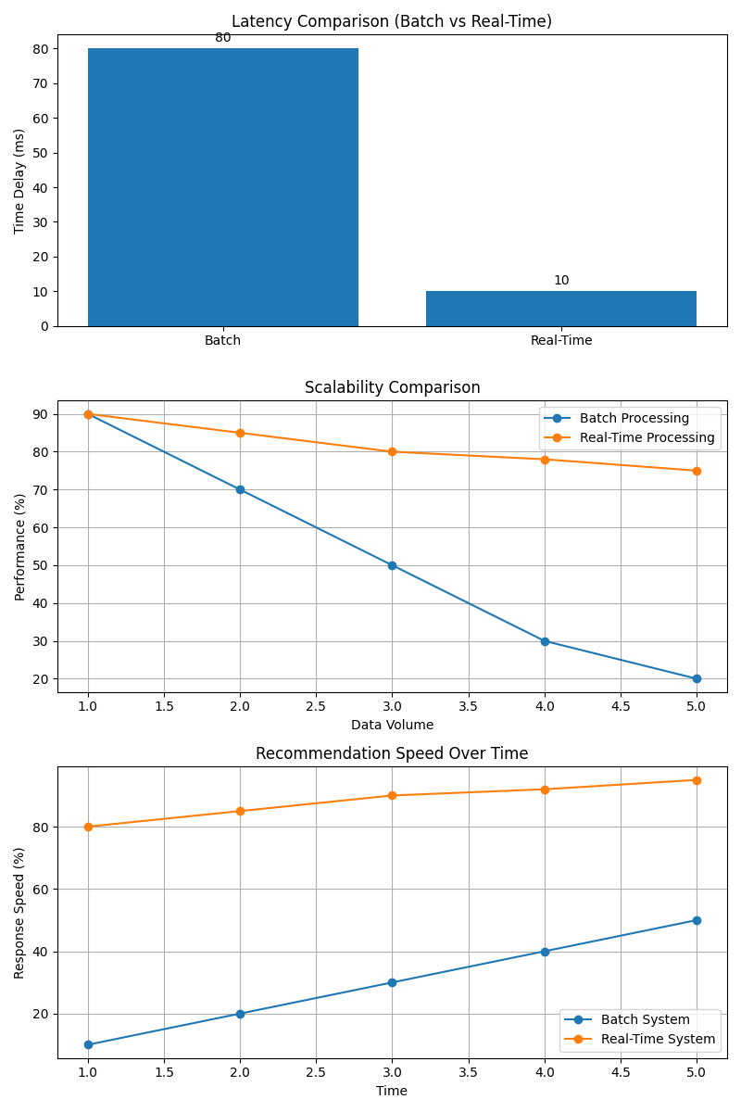
DISCUSSION

Slide 12
RESULTS
Key Results Achieved
Customer purchase patterns were successfully analyzed using historical retail data.
High-value customers and frequently purchased products were identified.
Product recommendations were generated using association rule mining (Apriori).
Customer segmentation using K-Means enabled targeted analysis.
Interactive dashboards provided clear insights into sales trends and customer behavior.
Performance Improvements
Latency: Data processing time reduced by using optimized data handling techniques compared to manual analysis.
Scalability: System can handle increasing transaction data with integration of big data tools like Spark and Kafka.
Recommendation Speed: Product recommendations generated quickly based on purchase history.
System Efficiency: Automated analytics improved decision-making speed and reduced manual effort.
Output Highlights
Frequently bought product combinations identified (market basket analysis).
Customer segments like high spenders and frequent buyers identified.
Sales trends and category-wise performance visualized.
Personalized product recommendations generated for users.
Insights displayed through dashboards (Power BI / charts).
Final Outcome
The proposed system successfully demonstrates a data-driven retail analytics and recommendation solution that improves business insights, enhances customer understanding, and supports better decision-making using big data technologies.
One-Line Conclusion
The system delivers faster insights and effective product recommendations by combining data analytics, clustering, and association rule mining techniques.

Slide 13
CONCLUSION
The project successfully implements a customer purchase analytics and recommendation system using modern data analytics and big data concepts. By integrating data collection, preprocessing, analysis, machine learning techniques, and visualization modules, the system is able to continuously analyze customer purchase behavior and generate meaningful insights.
Compared to traditional manual or basic analytical approaches, the proposed system significantly improves the ability to understand customer patterns and product performance. The use of structured data processing and analytical techniques enables efficient handling of large volumes of retail transaction data while maintaining accuracy and consistency.
The recommendation module enhances business value by providing product suggestions based on customer purchase history and frequently bought item combinations. This helps in identifying cross-selling opportunities and improving customer engagement. Additionally, customer segmentation using clustering techniques allows businesses to target specific customer groups more effectively.
The visualization dashboards provide clear and interactive insights into sales trends, customer behavior, and product performance. These insights support data-driven decision-making and improve overall business strategies.
Overall, the system demonstrates how data analytics, clustering, and association rule mining can be effectively combined to build an intelligent, scalable, and efficient retail analytics platform.
Final Statement:
The project highlights the importance of data-driven analytics in modern retail systems and provides a scalable solution for improving customer understanding, recommendation accuracy, and business decision-making.

Slide 14
FUTURE DIRECTIONS
Enhancements in Recommendation System
Incorporate advanced machine learning models such as hybrid recommendation techniques.
Improve accuracy by combining collaborative filtering with association rule mining (Apriori).
Introduce real-time recommendation updates using streaming data (Kafka + Spark).
Enhance personalization by analyzing deeper customer behavior patterns.
Scalability and Performance
Deploy the system on cloud platforms (AWS / Azure) for better scalability and availability.
Use distributed processing frameworks (Apache Spark, Hadoop) to handle large datasets.
Improve performance using parallel processing and optimized data pipelines.
Enable auto-scaling mechanisms to handle increasing user traffic and data volume.
Data Expansion
Integrate additional data sources such as customer feedback, ratings, and reviews.
Include contextual data like time of purchase, location, and seasonal trends.
Improve data quality through advanced preprocessing and validation techniques.
Incorporate real-time streaming data for dynamic analysis.
Advanced Analytics
Implement predictive analytics to forecast future purchase behavior.
Apply customer lifetime value (CLV) analysis for better targeting.
Introduce anomaly detection to identify unusual buying patterns or fraud.
Use advanced clustering techniques for more refined customer segmentation.
User Experience Improvements
Develop a more interactive dashboard with better visualization.
Provide explainable recommendations to increase user trust.
Enable personalized product suggestions based on user preferences.
Improve UI for easier navigation and better engagement.
Security and Privacy
Implement data encryption and secure authentication mechanisms.
Ensure customer data privacy through data anonymization techniques.
Follow data protection standards and compliance policies.
Introduce role-based access control for system management.

Slide 15
REFERENCES
References
Han, J., Kamber, M., & Pei, J. (2011). Data Mining: Concepts and Techniques. Morgan Kaufmann.
Géron, A. (2019). Hands-On Machine Learning with Scikit-Learn, Keras, and TensorFlow. O’Reilly Media.
Kumar, S., & Sharma, R. (2022). Customer Segmentation in Retail using K-Means Clustering. IEEE International Conference on Big Data Analytics.
Han, J., Kamber, M., & Pei, J. (2021). Market Basket Analysis using Apriori Algorithm for Retail Data. International Journal of Data Mining & Knowledge Management.
UCI Machine Learning Repository. Online Retail Dataset. Available at: https://archive.ics.uci.edu/ml/datasets/Online+Retail
Kaggle. Retail / Supermarket Sales Dataset. Available at: https://www.kaggle.com/datasets
Big Data & Tools References
Apache Kafka Documentation. Available at: https://kafka.apache.org/documentation/
Apache Spark Documentation. Available at: https://spark.apache.org/docs/latest/
Hadoop HDFS Documentation. Available at: https://hadoop.apache.org/docs/
MongoDB Documentation. Available at: https://www.mongodb.com/docs/
Analytics & Visualization
Microsoft Power BI Documentation. Available at: https://learn.microsoft.com/power-bi/
Matplotlib Documentation. Available at: https://matplotlib.org/stable/contents.html

Slide 16


